Slide 1
Checking understanding of arithmetic procedures with integers and decimals
Arithmetic procedures with integers and decimals

Slide 2
how to use Oak lessons

Slide 3
I can add, subtract, multiply and divide with integers and decimals.

Slide 4
An integer is any positive or negative whole number or zero. E.g. (−2), 0, 153 are all examples of integers.
A number is in decimal form when the decimal point is shown and there are digits to the right of the decimal point.
A digit is one of the symbols of a number system. In our number system we use the digits 0, 1, 2, 3, 4, 5, 6, 7, 8 and 9.

Slide 5

Checking understanding of arithmetic procedures with integers and decimals
Arithmetic procedures with integers
Addition and subtraction of decimals
Multiplication and division of decimals

Slide 6
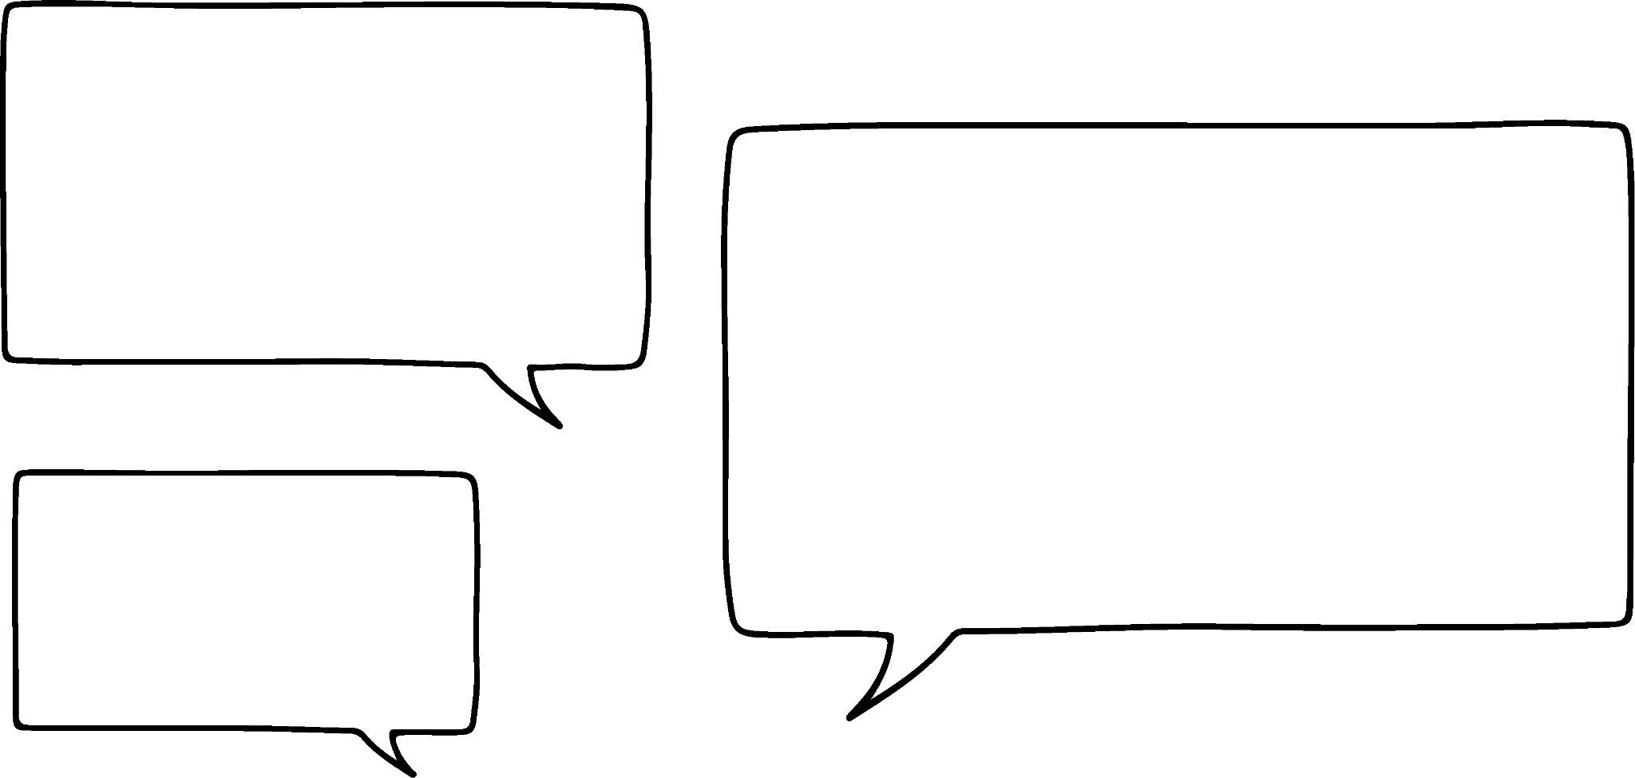
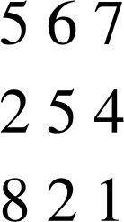


Arithmetic procedures with integers
Izzy and Lucas are working on this problem.
They need to find the missing digits.
This doesn’t work. You can’t get a 1 in the ones column as you already have 7 ones in the top number.
+
Yes it does. If you add 4 to 7 you get 11 which has 1 one.

Slide 7
Arithmetic procedures with integers
I think the hexagon and cloud could be any digit.
What do you think Lucas?
+
I think they could be any digits that sum to 7.
Do you agree or disagree with Lucas?
You should agree with Lucas.
What could they be?

Slide 8
Arithmetic procedures with integers
What could they be?
+
1
1
Lucas was right, the square must be 4 for the ones digits in the sum to be 1.
The triangle has to be 2 as the sum of 6, 5 and 1 is 12.
So, Lucas was right. The hundreds digits have to sum to 7.
They could be 1 & 6, 2 & 5 or 3 & 4 in either order.

Slide 9
Arithmetic procedures with integers
+
1
1
Here are some more clues for the puzzle:
The larger number is on the top.
The difference between the hundreds digits is 3
Is there still more than one solution?
No, the hexagon is 5 and the cloud is 2.

Slide 10
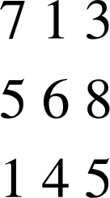
Arithmetic procedures with integers
What are the missing digits in this calculation?
6
0
1
1
13
. − 8 =.5
−
0. − =.4
1
6

Slide 11
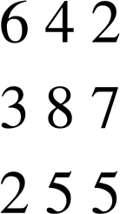
Arithmetic procedures with integers
What are the missing digits in this calculation?
−
= 2
= 8
= 2

Slide 12
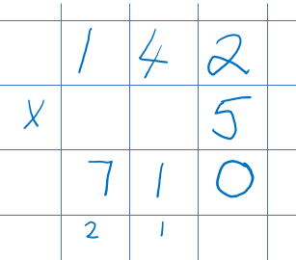


Arithmetic procedures with integers
Sam is working out the answer to 142 × 5
This is their working out
What are you doing?
There is a much quicker way to multiply by 5.
I always multiply by 10 and halve it.
Really?
How do you do it?
142 × 10 = 1420
1420 ÷ 2 = 710

Slide 13
Arithmetic procedures with integers
Think of other ways to perform arithmetic procedures in a more efficient way:
 | Alternative
× 5 | × 10 ÷ 2
× 4 | × 2 × 2
× 6 | × 3 × 2
× 8 | × 2 × 2 × 2
÷ 5 | ÷ 10 × 2

Slide 14

Arithmetic procedures with integers
Which of the following is another way to divide by 9?
÷ 2 ÷ 7
÷ 3 ÷ 3
÷ 6 ÷ 3

Slide 15
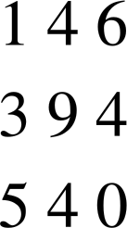
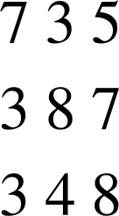
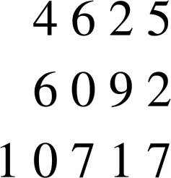
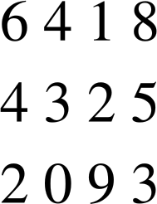
Arithmetic procedures with integers
Find the missing digits in each of the following:
a)
b)
c)
d)
+
−
+
−

Slide 16
Arithmetic procedures with integers
2) Calculate the following, without a calculator. Try to use the efficient methods we have just talked about.
580 × 5
87 × 4
26 × 8
45 × 6
485 ÷ 5

Slide 17
Arithmetic procedures with integers
Find the missing digits in each of the following:
a)
b)
c)
d)
+
−
+
−

Slide 18
Arithmetic procedures with integers
2) Calculate the following, without a calculator. Try to use the efficient methods we have just talked about.
580 × 5
87 × 4
26 × 8
45 × 6
485 ÷ 5
= 580 × 10 ÷ 2 = 5800 ÷ 2 = 2900
= 87 × 2 × 2 = 174 × 2 = 348
= 26 × 2 × 2 × 2 = 52 × 2 × 2 = 104 × 2 = 208
= 45 × 3 × 2 = 135 × 2 = 270
= 485 ÷ 10 × 2 = 48.5 × 2 = 97

Slide 19
Checking understanding of arithmetic procedures with integers and decimals
Arithmetic procedures with integers
Addition and subtraction of decimals
Multiplication and division of decimals

Slide 20
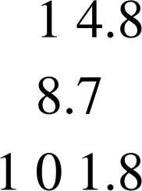
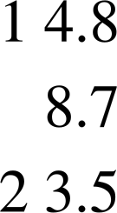
Addition and subtraction of decimals
Alex and Jun are hoping to enter a team competition.
Their total time must be less than 24 seconds.
Alex takes 14.8 seconds and Jun takes 8.7 seconds.
Can they enter the competition?
+
+
Which is the correct way to set out the calculation?

Slide 21
Addition and subtraction of decimals
+
+
Why is the one in the box the correct way?
The decimal points are in line.
The decimal point determines the place value of each digit so we have to line them up when adding & subtracting.

Slide 22

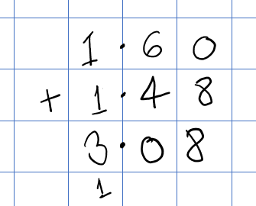

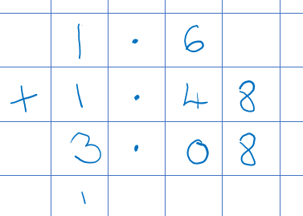
Addition and subtraction of decimals
Alex and Jun now measure their height in metres.
They want to find the total of their heights.
Here is my workings.
I am 1.6 metres tall.
And, here is mine.
I’m 1.48 metres
What is the same and what is different about their workings?
e.g. They both lined up the decimal points.
They both got the same answer.
Jun didn’t put the zero in the hundredths column.

Slide 23
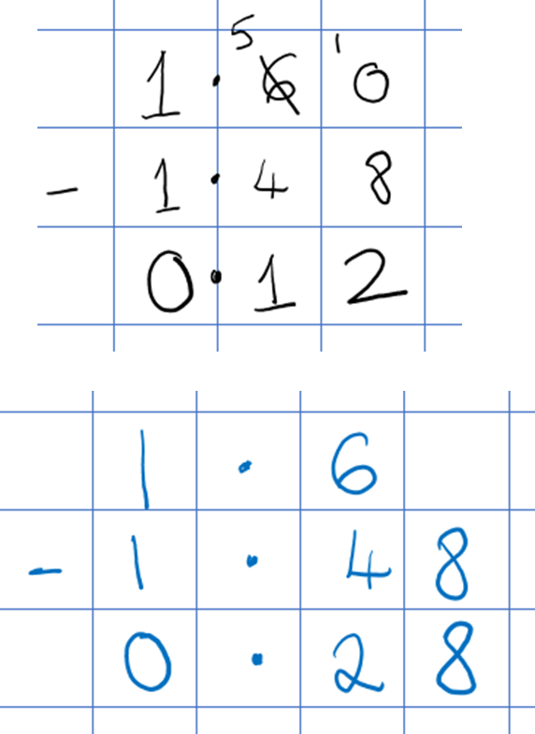
Addition and subtraction of decimals
How much taller is Alex than Jun?
Here is my workings.
I am 1.6 metres tall
And, here is mine.
I’m 1.48 metres
What is the same and what is different about their workings?
e.g. They both lined up the decimal points.
They got different answers.
Jun didn’t put the zero in the hundredths column so he couldn’t see the 0 hundredths minus 8 hundredths so his answer is incorrect.

Slide 24


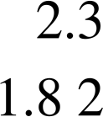
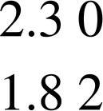
Addition and subtraction of decimals
Alex’s sunflower is 1.82 metres tall and Jun’s is 2.3 metres tall.
How much taller is Jun’s?
Which is the correct way of setting out this calculation?
a
b
c
−
+
−

Slide 25



Addition and subtraction of decimals
Sofia and Andeep record how far they kick a football.
What is the total distance?
How much further did Sofia kick the ball?
I kicked it 9.8 metres.
I kicked it 12.73 metres.

Slide 26



Addition and subtraction of decimals
2) Lucas, Aisha and Jun record how long they can bounce a basketball for.
What is the total time?
How much longer did Lucas manage than Jun?
I did 35.6 seconds.
I did 28.45 seconds.
And, I managed 27.87 seconds.

Slide 27
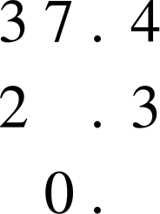
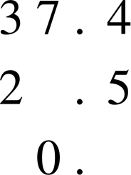
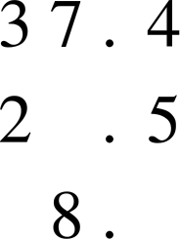
Addition and subtraction of decimals
3) Here are three slightly different subtractions.
a)
b)
c)
−
−
−
Without calculating, explain why the following statements are false.
The digit in the must be 1 in each calculation as the tenths digits are one apart.
The digit in the must be 7 in both cases as the difference is 0.
The digit in the must be 1 in all three calculations as 3 - 2 = 1
Find the missing digits.

Slide 28
Addition and subtraction of decimals
Sofia and Andeep record how far they kick a football.
What is the total distance? 22.53 metres
How much further did Sofia kick the ball? 2.93 metres
I kicked it 9.8 metres.
I kicked it 12.73 metres.

Slide 29
Addition and subtraction of decimals
2) Lucas, Aisha and Jun record how long they can bounce a basketball for.
What is the total time? 91.92 seconds
How much longer did Lucas manage than Jun? 7.73 seconds
I did 35.6 seconds.
I did 28.45 seconds.
And, I managed 27.87 seconds.

Slide 30
Addition and subtraction of decimals
3) Here are three slightly different subtractions.
a)
b)
c)
−
7
−
6
−
8
1
1
1
9
0
9
Without calculating, explain why the following statements are false.
The digit in the must be 1 in each calculation as the tenths digits are one apart. True for a but not b & c, as we subtract the bottom digit from the top
The digit in the must be 7 in both cases as the difference is 0. True for a but not b, as the 1 of the ones would have been exchanged for 10 tenths
The digit in the must be 1 in all three calculations as 3 − 2 = 1 True for a & b but not c, as 1 of the tens would have been exchanged for 10 ones
Find the missing digits.

Slide 31
Checking understanding of arithmetic procedures with integers and decimals
Arithmetics procedures with integers
Addition and subtraction of decimals
Multiplication and division of decimals

Slide 32

Multiplication and division of decimals
Jacob buys 5 boxes of chocolates.
What is the total cost?
£3.86
Can you remember Laura’s method from earlier?
An alternative to multiplying by 5 is multiplying by 10 and halving.
Remember we can partition £38.60
£3.86 x 5
= £3.86 x 10 ÷ 2
£38.60
= £38.60 ÷ 2
£30
£8
£0.60
= £19.30
÷ 2
£15
£4
+
£0.30
The total cost is £19.30
+

Slide 33
Multiplication and division of decimals
Aisha raises £122.50 doing a sponsored silence.
She wants to divide it between her 5 favourite charities.
How much does each charity get?
An alternative to dividing by 5 is dividing by 10 and doubling.
Again, you can partition £12.25 if you need to
£122.50 ÷ 5
= £122.5 ÷ 10 × 2
£12.25
= £12.25 × 2
£10
£2
£0.25
= £24.50
× 2
£20
£4
+
£0.50
Each charity gets £24.50
+

Slide 34
Multiplication and division of decimals
Spot the mistake and correct the mistake
362 ÷ 5
= 362 ÷ 10 ÷ 2
= 36.2 ÷ 2
= 18.1
362 ÷ 5
= 362 ÷ 10 × 2
= 36.2 × 2
= 72.4

Slide 35
Multiplication and division of decimals
Match the operation on the left to its equivalent on the right.
× 5
× 2 × 2 × 2
÷ 4
÷ 2 ÷ 2
× 8
÷ 2 ÷ 3
÷ 5
× 10 ÷ 2
÷ 6
× 2 × 3
× 6
÷ 10 × 2

Slide 36
Multiplication and division of decimals
2) Find the cost of the following:
2 boxes
10 boxes
5 boxes
6 boxes
3) The Oak students decide to buy one box of chocolates between them.
Work out how much each person pays if:
2 students buy the box
4 students buy the box
5 students buy the box
£4.75
£5.80

Slide 37
Multiplication and division of decimals
Match the operation on the left to its equivalent on the right.
× 5
× 2 × 2 × 2
÷ 4
÷ 2 ÷ 2
× 8
÷ 2 ÷ 3
÷ 5
× 10 ÷ 2
÷ 6
× 2 × 3
× 6
÷ 10 × 2

Slide 38
Multiplication and division of decimals
2) Find the cost of the following:
2 boxes £9.50
10 boxes £47.50
5 boxes £23.75
6 boxes £28.50
3) The Oak students decide to buy one box of chocolates between them.
Work out how much each person pays if:
2 students buy the box £2.90
4 students buy the box £1.45
5 students buy the box £1.16
£4.75
£5.80

Slide 39
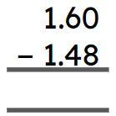
Checking understanding of arithmetic procedures with integers and decimals
Understanding of arithmetic procedures allows you to make calculations easier with both integers and decimals.
E.g. an alternative way of multiplying by 5 is to multiply by 10 and then divide by 2
The importance of the decimal point when adding and subtracting decimals.
Place holders must be used when subtracting decimals.
E.g.

Slide 40

© Oak National Academy 2023.
Produced in partnership with Mathematics in Education and Industry.
Licensed on the Open Government Licence v3.0, except where otherwise stated. See Oak terms and conditions.

